Slide 1
Graph Algorithms
Avinash Kumar Sharma
Assistant Professor, Department of CSE
ABES Institute of Technology, Ghaziabad

Slide 2
What is a Graph?
Graph G = (V,E) ( simple, Undirected)
  Set V of vertices (nodes): A non-empty finite set
  Set E of edges: E ⊆V² , 2-element subsets of V.
    Elements of E are unordered pairs {v,w} where v,w ∈ V.
  So a graph is an ordered pair of two sets V and E.
Variations: Directed graph, ( E ⊆ V ×V)
Weighted graph
  W: E→R, c: V →R

Slide 3
What is a Graph?
Modeling view:
G=(V,E)
  V: A finite set of objects
  E: A symmetric, irreflexive binary relation on V.
  When E becomes just a relation it gives rise to a directed graph.

Slide 4
What is a Graph?
Any n X n 0-1 symmetric matrix is a graph
  Vertices are row ( colum) numbers and there is an edge between two vertices i and j if the ij th entry is 1. (Adjacency matrix)

Slide 5
Graphs: Diagramatic representation
Vertices (aka nodes)

Slide 6
Graphs — Diagramatic Representation
Vertices (aka nodes)
3
2
1
4
5
6
Edges

Slide 7
Graphs — Weighted graphs
Vertices (aka nodes)
3
618
2
1
2273
211
190
4
318
344
1987
5
2145
2462
6
Weights
Undirected
Edges

Slide 8
Directed Graph (digraph)
Vertices (aka nodes)
3
2
1
4
5
6
Edges

Slide 9
Why Graph Theory?
Discrete Mathematics and in particular Graph Theory is the language of Computer Scientist.
Tarjan & Hopcroft ( 1986): ACM Turing Award
  For fundamental contributions to “ Graph Algorithms and Data structures”
    Planarity testing and Splay Trees are Key contributions among others.
  Navanlina Prize in ICM 2010 ( Hyderabad) Daniel Spielman for his work “ Application of Graph Theory to Computer Science”

Slide 10
Why Graph Theory?
ABEL PRIZE ( 2012) Endre Szemeredi
  For his fundamental contributions to Discrete Mathematics and Theoretical computer Science
Is P=NP? ( 1 Milion $ open Problem)
Many Decision problems concerning Graphs are NP Complete. ( HC Decision Problem etc)
P=NP iff any NP-complete problem belongs to P.
One possible way of attacking the above problem is through Graph Theory .

Slide 11
Terminology
Path: a sequence of vertices (v[1], v[2],...,v[k]) s.t. (v[i],v[i+1]) ∈ E for all 0 < i < k
Simple Path: No vertex is repeated in a simple path
The length of a path is number of vertices in it minus 1.
Cycle : a simple path that begins and ends with the same node
Cyclic graph – contains at least one cycle
Acyclic graph - no cycles

Slide 12
Terminology, cont’d
Subgraph of a graph G =(V,E) is H=(V’,E’) if V’⊆V and E’ ⊆E.
Vertex Induced Subgraph: Induced by vertex set S, G[S]=(S,E’), where E’ ={ xy| xy ∈ E and x,y ∈S}.
Edge Induced subgraph: Induced by E’ , G[E’]=(V’,E’), V’={x| xy ∈E’ for some y ∈V}
Connected graph: a graph where for every pair of nodes there exists a path between them.
Connected component of a graph G
a maximal connected subgraph of G.

Slide 13
Tree
A connected acyclic Graph is a tree.
Spanning tree of a connected graph G=(V,E): a sub graph T=(V,E’) of G, and T is a tree, i.e. T spans the whole of V of G.
W(T)= sum of the weights of all edges of T.
Minimum Spanning Tree ( MST): Spanning tree having minimum weight of a edge weighted connected graph.

Slide 14
Graph Representation
Two popular computer representations of a graph. Both represent the vertex set and the edge set, but in different ways.
  Adjacency Matrix
    Use a 2D matrix to represent the graph
  Adjacency List
    Use a 1D array of linked lists

Slide 15
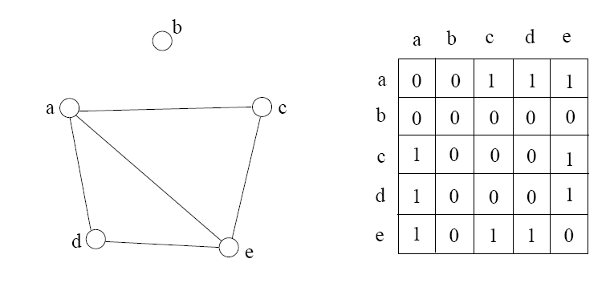
Adjacency Matrix
2D array A[0..n-1, 0..n-1], where n is the number of vertices in the graph
Each row and column is indexed by the vertex id
  e,g a=0, b=1, c=2, d=3, e=4
A[i][j]=1 if there is an edge connecting vertices i and j; otherwise, A[i][j]=0
The storage requirement is Θ(n²). It is not efficient if the graph has few edges. An adjacency matrix is an appropriate representation if the graph is dense: |E|=Θ(|V|²)
We can detect in O(1) time whether two vertices are connected.

Slide 16
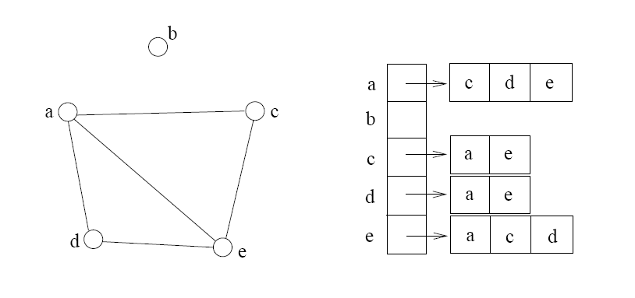
Adjacency List
If the graph is not dense, in other words, sparse, a better solution is an adjacency list
The adjacency list is an array A[0..n-1] of lists, where n is the number of vertices in the graph.
Each array entry is indexed by the vertex id
Each list A[i] stores the ids of the vertices adjacent to vertex i

Slide 17
Adjacency Matrix Example
0
 | 0 | 1 | 2 | 3 | 4 | 5 | 6 | 7 | 8 | 9
0 | 0 | 0 | 0 | 0 | 0 | 0 | 0 | 0 | 1 | 0
1 | 0 | 0 | 1 | 1 | 0 | 0 | 0 | 1 | 0 | 1
2 | 0 | 1 | 0 | 0 | 1 | 0 | 0 | 0 | 1 | 0
3 | 0 | 1 | 0 | 0 | 1 | 1 | 0 | 0 | 0 | 0
4 | 0 | 0 | 1 | 1 | 0 | 0 | 0 | 0 | 0 | 0
5 | 0 | 0 | 0 | 1 | 0 | 0 | 1 | 0 | 0 | 0
6 | 0 | 0 | 0 | 0 | 0 | 1 | 0 | 1 | 0 | 0
7 | 0 | 1 | 0 | 0 | 0 | 0 | 1 | 0 | 0 | 0
8 | 1 | 0 | 1 | 0 | 0 | 0 | 0 | 0 | 0 | 1
9 | 0 | 1 | 0 | 0 | 0 | 0 | 0 | 0 | 1 | 0
8
2
9
1
3
7
6
4
5

Slide 18
Adjacency List Example
0
0
1
2
3
4
5
6
7
8
9
8
2 | 3 | 7 | 9
8
1 | 4 | 8
2
9
1 | 4 | 5
1
2 | 3
7
3 | 6
3
6
5 | 7
4
5
1 | 6
0 | 2 | 9
1 | 8

Slide 19
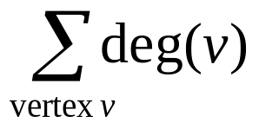
Storage of Adjacency List
The array takes up Θ(n) space
Define degree of v, deg(v), to be the number of edges incident to v. Then, the total space to store the graph is proportional to:
An edge e={u,v} of the graph contributes a count of 1 to deg(u) and contributes a count 1 to deg(v)
Therefore, Σ_{vertex v}deg(v) = 2m, where m is the total number of edges
In all, the adjacency list takes up Θ(n+m) space
  If m = O(n²) (i.e. dense graphs), both adjacent matrix and adjacent lists use Θ(n²) space.
  If m = O(n), adjacent list outperform adjacent matrix
However, one cannot tell in O(1) time whether two vertices are connected

Slide 20
Adjacency List vs. Matrix
Adjacency List
  More compact than adjacency matrices if graph has few edges
  Requires more time to find if an edge exists
Adjacency Matrix
  Always require n² space
    This can waste a lot of space if the number of edges are sparse
  Can quickly find if an edge exists

Slide 21
Graph Traversals
BFS ( breadth first search)
DFS ( depth first search)

Slide 22
Algorithm Generic GraphSearch
for i=1 to n do
{
Mark[i]=0; P[i]=0;
}
Mark[1]=1; P[1]=1; Num[1]=1; Count=2; S={1};
While ( S ≠ V)
{
select a vertex x from S;
if ( x has an unmarked neighbor y)
{
Mark[y]=1; P[y]=x; Num[y]=count; count=count+1;
S=S∪ {y};
}
else S=S-{x};
}
}

Slide 23
BFS and DFS
If S is implemented using a Queue, the search becomes BFS
If S is implemented using a stack, the search becomes DFS

Slide 24
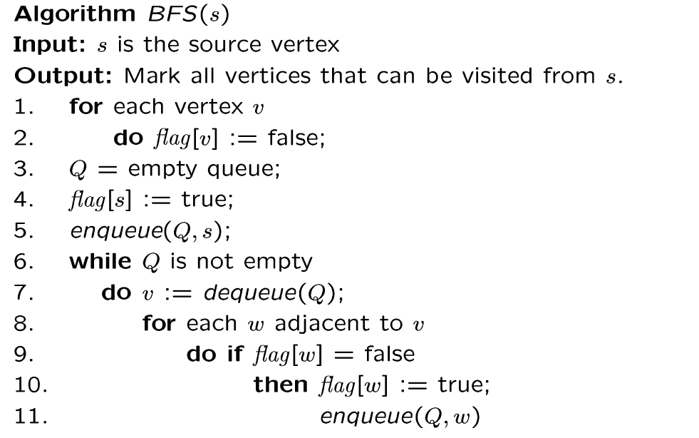
BFS Algorithm
// flag[ ]: visited table
Why use queue? Need FIFO

Slide 25
BFS
for each vertex v
  flag[v]=false;
  For all vertices v
  if (flag[v]=false) BFS(v);

Slide 26
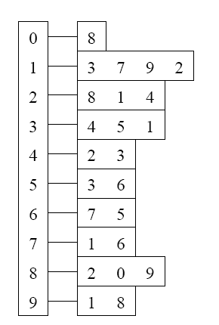
BFS Example
Adjacency List
Visited Table (T/F)
0
1
2
3
4
5
6
7
8
9
F
F
F
F
F
F
F
F
F
F
0
8
source
2
9
1
3
7
6
4
5
Initialize visited
table (all False)
Q =
{ }
Initialize Q to be empty

Slide 27
Adjacency List
Visited Table (T/F)
0
1
2
3
4
5
6
7
8
9
F
F
T
F
F
F
F
F
F
F
0
8
source
2
9
1
3
7
6
4
5
Flag that 2 has
been visited
Q =
{ 2 }
Place source 2 on the queue

Slide 28
Adjacency List
Visited Table (T/F)
0
1
2
3
4
5
6
7
8
9
F
T
T
F
T
F
F
F
T
F
0
8
Neighbors
source
2
9
1
3
7
6
4
5
Mark neighbors
as visited 1, 4, 8
Q =
{2} → { 8, 1, 4 }
Dequeue 2.
Place all unvisited neighbors of 2 on the queue

Slide 29
Adjacency List
Visited Table (T/F)
0
1
2
3
4
5
6
7
8
9
T
T
T
F
T
F
F
F
T
T
0
8
source
2
9
1
3
7
Neighbors
6
4
5
Mark new visited
Neighbors 0, 9
Q =
{ 8, 1, 4 } → { 1, 4, 0, 9 }
Dequeue 8.
-- Place all unvisited neighbors of 8 on the queue.
-- Notice that 2 is not placed on the queue again, it has been visited!

Slide 30
Adjacency List
Visited Table (T/F)
0
1
2
3
4
5
6
7
8
9
T
T
T
T
T
F
F
T
T
T
0
Neighbors
8
source
2
9
1
3
7
6
4
5
Mark new visited
Neighbors 3, 7
Q =
{ 1, 4, 0, 9 } → { 4, 0, 9, 3, 7 }
Dequeue 1.
-- Place all unvisited neighbors of 1 on the queue.
-- Only nodes 3 and 7 haven’t been visited yet.

Slide 31
Adjacency List
Visited Table (T/F)
0
1
2
3
4
5
6
7
8
9
T
T
T
T
T
F
F
T
T
T
0
8
source
2
9
Neighbors
1
3
7
6
4
5
Q =
{ 4, 0, 9, 3, 7 } → { 0, 9, 3, 7 }
Dequeue 4.
-- 4 has no unvisited neighbors!

Slide 32
Adjacency List
Visited Table (T/F)
Neighbors
0
1
2
3
4
5
6
7
8
9
T
T
T
T
T
F
F
T
T
T
0
8
source
2
9
1
3
7
6
4
5
Q =
{ 0, 9, 3, 7 } → { 9, 3, 7 }
Dequeue 0.
-- 0 has no unvisited neighbors!

Slide 33
Adjacency List
Visited Table (T/F)
0
1
2
3
4
5
6
7
8
9
T
T
T
T
T
F
F
T
T
T
0
8
source
2
9
1
3
7
6
4
5
Neighbors
Q =
{ 9, 3, 7 } → { 3, 7 }
Dequeue 9.
-- 9 has no unvisited neighbors!

Slide 34
Adjacency List
Visited Table (T/F)
0
1
2
3
4
5
6
7
8
9
T
T
T
T
T
T
F
T
T
T
0
8
Neighbors
source
2
9
1
3
7
6
4
5
Mark new visited
Vertex 5
Q =
{ 3, 7 } → { 7, 5 }
Dequeue 3.
-- place neighbor 5 on the queue.

Slide 35
Adjacency List
Visited Table (T/F)
0
1
2
3
4
5
6
7
8
9
T
T
T
T
T
T
T
T
T
T
0
8
source
2
9
1
7
Neighbors
3
6
4
5
Mark new visited
Vertex 6
Q =
{ 7, 5 } → { 5, 6 }
Dequeue 7.
-- place neighbor 6 on the queue

Slide 36
Adjacency List
Visited Table (T/F)
0
1
2
3
4
5
6
7
8
9
T
T
T
T
T
T
T
T
T
T
0
8
source
2
9
Neighbors
1
3
7
6
4
5
Q =
{ 5, 6} → { 6 }
Dequeue 5.
-- no unvisited neighbors of 5

Slide 37
Adjacency List
Visited Table (T/F)
0
1
2
3
4
5
6
7
8
9
T
T
T
T
T
T
T
T
T
T
0
8
source
2
9
1
Neighbors
3
7
6
4
5
Q =
{ 6 } → { }
Dequeue 6.
-- no unvisited neighbors of 6

Slide 38
Adjacency List
Visited Table (T/F)
0
1
2
3
4
5
6
7
8
9
T
T
T
T
T
T
T
T
T
T
0
8
source
2
9
1
3
7
6
4
5
What did we discover?
Look at “visited” tables.
There exists a path from source
vertex 2 to all vertices in the graph
Q =
{ }
STOP!!! Q is empty!!!

Slide 39
Time Complexity of BFS
(Using Adjacency List)
Assume adjacency list
  n = number of vertices m = number of edges
O(n + m)
Each vertex will enter Q
at most once.
Each iteration takes time proportional to deg(v) + 1 (the number 1 is to account for the case where deg(v) = 0 --- the work required is 1, not 0).

Slide 40
Running Time
Recall: Given a graph with m edges, what is the total degree?
The total running time of the while loop is:
this is summing over all the iterations in the while loop!
Σ_{vertex v} deg(v) = 2m
O( Σ_{vertex v} (deg(v) + 1) ) = O(n+m)

Slide 41
Time Complexity of BFS
(Using Adjacency Matrix)
Assume adjacency Matrix
  n = number of vertices m = number of edges
O(n²)
Finding the adjacent vertices of v requires checking all elements in the row. This takes linear time O(n).
Summing over all the n iterations, the total running time is O(n²).
So, with adjacency matrix, BFS is O(n²) independent of the number of edges m.
With adjacent lists, BFS is O(n+m); if m=O(n²) like in a dense graph, O(n+m)=O(n²).

Slide 42
What Can you do with BFS?
Find all the connected components
Test whether G has a cycle or not
Find a spanning tree of a connected graph
Find shortest paths from s to every other vertices
Test whether a graph has an odd cycle
Many more!!!

Slide 43
MST and Its Algorithms
Avinash Kumar Sharma
Assistant Professor, Department of CSE
ABES INSTITUTE OF TECHNLOGY, GHAZIABAD

Slide 44
Tree
A connected acyclic Graph is a tree.
Spanning tree of a connected graph G=(V,E): a sub graph T=(V,E’) of G, and T is a tree, i.e. T spans the whole of V of G.
W(T)= sum of the weights of all edges of T.
Minimum Spanning Tree ( MST): Spanning tree having minimum weight of a edge weighted connected graph.

Slide 45
Definition of MST
Let G=(V,E) be a connected, undirected graph.
For each edge (u,v) in E, we have a weight w(u,v) specifying the cost (length of edge) to connect u and v.
We wish to find a (acyclic) subset T of E that connects all of the vertices in V and whose total weight is minimized.
Since the total weight is minimized, the subset T must be acyclic (no circuit).
Thus, T is a tree. We call it a spanning tree.
The problem of determining the tree T is called the minimum-spanning-tree problem.

Slide 46
Problem: Laying Telephone Wire
Central office

Slide 47
Wiring: Naïve Approach
Central office
Expensive!

Slide 48
Wiring: Better Approach
Central office
Minimize the total length of wire connecting the customers

Slide 49
Real Life Application of a MST
A cable TV company is laying cable in a new neighborhood. If it is constrained to bury the cable only along certain paths, then there would be a graph representing which points are connected by those paths. Some of those paths might be more expensive, because they are longer, or require the cable to be buried deeper; these paths would be represented by edges with larger weights. A minimum spanning tree would be the network with the lowest total cost.

Slide 50
MST Applications
power outlet
or light
Electrical
wiring
of a house
using
minimum
amount of
wires
(cables)

Slide 51
MST Applications

Slide 52
MST Applications

Slide 53
Graph
Representation

Slide 54
Minimum
Spanning
Tree
for
electrical
eiring

Slide 55
Cycle Property
f
8
Cycle Property:
  Let T be a minimum spanning tree of a weighted graph G. Let e be an edge of G that is not in T and let C be the cycle formed by e with T
  For every edge f of C, weight(f) ≤ weight(e)
  Proof:
  By contradiction
  If weight(f) > weight(e) we can get a spanning tree of smaller weight by replacing e with f
4
C
9
2
6
3
e
8
7
7
Replacing f with e yields
a better spanning tree
f
8
4
C
9
2
6
3
e
8
7
7
Minimum Spanning Trees

Slide 56
Partition Property
U
V
f
7
Partition Property:
  Consider a partition of the vertices of G into subsets U and V. Let e be an edge of minimum weight across the partition. There is a minimum spanning tree of G containing edge e
  Proof:
  Let T be an MST of G
  If T does not contain e, consider the cycle C formed by e with T and let f be an edge of C across the partition
  By the cycle property,
  weight(f) ≤ weight(e)
  Thus, weight(f) = weight(e)
  We obtain another MST by replacing f with e
4
9
2
5
8
8
e
3
7
Replacing f with e yields
another MST
U
V
f
7
4
9
2
5
8
8
e
3
7
Minimum Spanning Trees

Slide 57
Prim’s Algorithm
Initially discovered in 1930 by Vojtěch Jarník, then rediscovered in 1957 by Robert C. Prim
Starts off by picking any node within the graph and growing from there

Slide 58
Prim’s Algorithm Cont.
Label the starting node, A, with a 0 and all others with infinite
Starting from A, update all the connected nodes’ labels to A with their weighted edges if it less than the labeled value
Find the next smallest label and update the corresponding connecting nodes
Repeat until all the nodes have been visited

Slide 59
Prim’s Algorithm
Input: A connected Graph G=(V,E) and the cost matrix C of G.
Output: A Minimum spanning tree T=(V,E′) of G.
Method:
{
Step 1: Let u be any arbitrary vertex of G.
T=(V′,E′), where V′ = {u} and E′ = φ.
Step 2: while ( V′ ≠ V)
{
Choose a least cost edge from V′ to V-V′.
Let e=xy be a least cost edge such that x ∈V′ and y ∈ V-V′.
V′= V′∪ {x};
E′ = E′ ∪ { e };
}
}

Slide 60
The execution of Prim's algorithm
8
7
the root vertex
b
c
d
9
4
2
a
11
i
14
e
4
7
6
8
10
h
g
f
1
2
8
7
b
c
d
9
4
2
a
11
i
14
e
4
7
6
8
10
h
g
f
1
2

Slide 61
8
7
b
c
d
9
4
2
a
11
i
14
e
4
7
6
8
10
h
g
f
1
2
8
7
b
c
d
9
4
2
a
11
i
14
e
4
7
6
8
10
h
g
f
1
2

Slide 62
8
7
b
c
d
9
4
2
a
11
i
14
e
4
7
6
8
10
h
g
f
1
2
8
7
b
c
d
9
4
2
a
11
i
14
e
4
7
6
8
10
h
g
f
1
2

Slide 63
8
7
b
c
d
9
4
2
a
11
i
14
e
4
7
6
8
10
h
g
f
1
2
8
7
b
c
d
9
4
2
a
11
i
14
e
4
7
6
8
10
h
g
f
1
2

Slide 64
8
7
b
c
d
9
4
2
a
11
i
14
e
4
7
6
8
10
h
g
f
1
2
Bottleneck spanning tree: A spanning tree of G whose largest edge weight is minimum over all spanning trees of G. The value of the bottleneck spanning tree is the weight of the maximum-weight edge in T.
Theorem: A minimum spanning tree is also a bottleneck spanning tree. (Challenge problem)

Slide 65
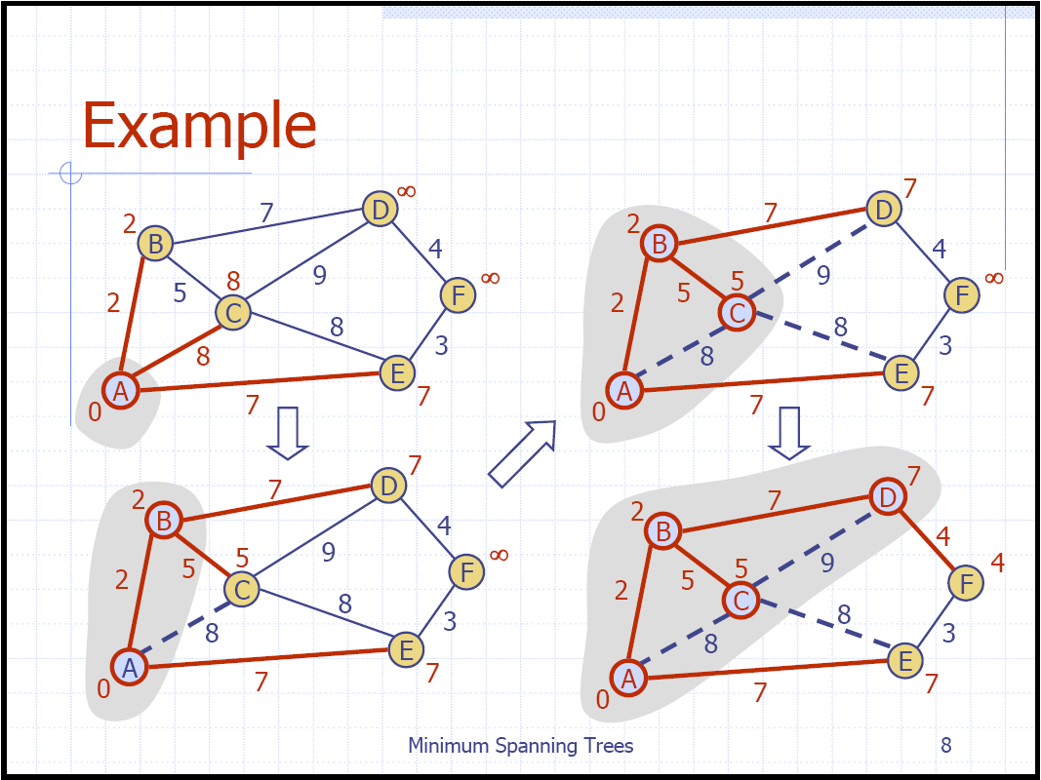
Prim’s Algorithm Example

Slide 66
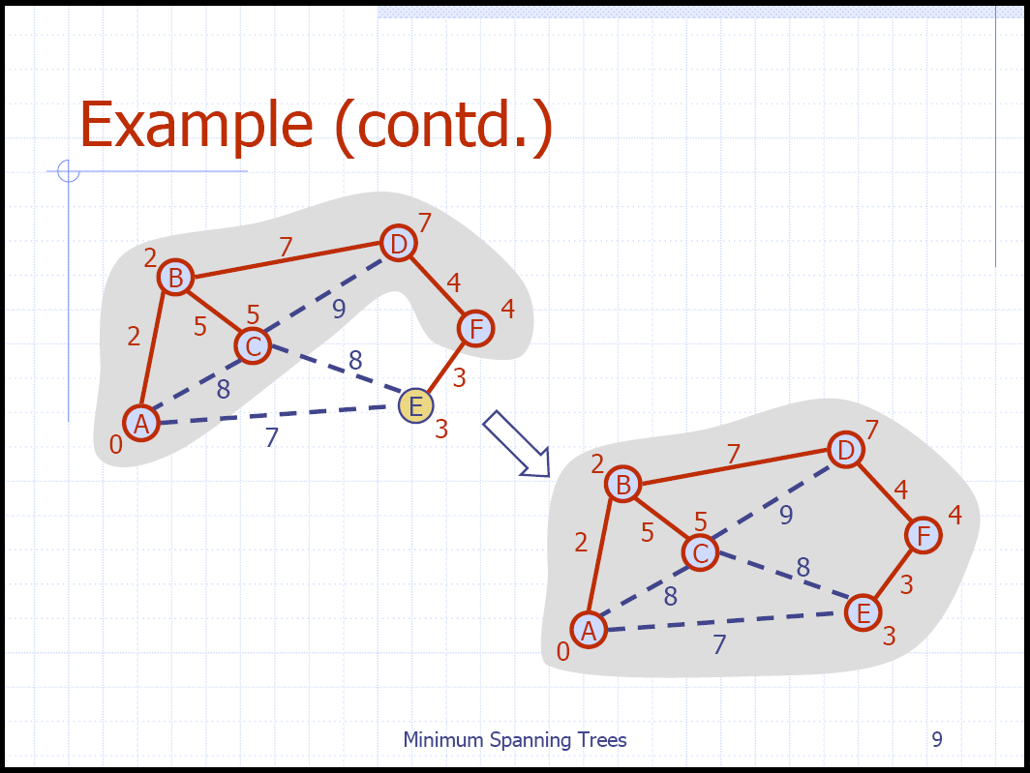
Prim’s Algorithm Example

Slide 67
Kruskal’s Algorithm (1956 by Joseph Kruskal)
Input: A connected Graph G=(V,E) and the cost matrix C of G.
Output: A Minimum spanning tree T=(V,E′) of G.
Method:
Step 1: Sort the edges of G in the non-decreasing order of their costs.
Let the sorted list edges be e₁, e₂,…., e_{m}.
Step 2: T=(V, E′), where E′=φ. i=1; count=0;
while ( count < n-1 and i < m)
{
if ( T=(V, E′ ∪ { e_{i} }) is acyclic)
{ E′ = E′ ∪ { e_{i} }; count= count+1;}
i=i+1;
}

Slide 68
The execution of Kruskal's algorithm
The edges are considered by the algorithm in sorted order by weight.
The edge under consideration at each step is shown with a red weight number.
8
7
b
c
d
9
4
2
a
11
i
14
e
4
7
6
8
10
h
g
f
1
2

Slide 69
8
7
b
c
d
9
4
2
a
11
i
14
e
4
7
6
8
10
h
g
f
1
2
8
7
b
c
d
9
4
2
a
11
i
14
e
4
7
6
8
10
h
g
f
1
2

Slide 70
8
7
b
c
d
9
4
2
a
11
i
14
e
4
7
6
8
10
h
g
f
1
2
8
7
b
c
d
9
4
2
a
11
i
14
e
4
7
6
8
10
h
g
f
1
2

Slide 71
8
7
b
c
d
9
4
2
a
11
i
14
e
4
7
6
8
10
h
g
f
1
2
8
7
b
c
d
9
4
2
a
11
i
14
e
4
7
6
8
10
h
g
f
1
2

Slide 72
8
7
b
c
d
9
4
2
a
11
i
14
e
4
7
6
8
10
h
g
f
1
2
8
7
b
c
d
9
4
2
a
11
i
14
e
4
7
6
8
10
h
g
f
1
2

Slide 73
8
7
b
c
d
9
4
2
a
11
i
14
e
4
7
6
8
10
h
g
f
1
2
8
7
b
c
d
9
4
2
a
11
i
14
e
4
7
6
8
10
h
g
f
1
2

Slide 74
Growing a MST(Generic Algorithm)
GENERIC_MST(G,w)
1 A:={}
2 while A does not form a spanning tree do
3 find an edge (u,v) that is safe for A
4 A:=A∪{(u,v)}
5 return A
Set A is always a subset of some minimum spanning tree. This property is called the invariant Property.
An edge (u,v) is a safe edge for A if adding the edge to A does not destroy the invariant.
A safe edge is just the CORRECT edge to choose to add to T.

Slide 75
How to find a safe edge
We need some definitions and a theorem.
A cut (S,V-S) of an undirected graph G=(V,E) is a partition of V.
An edge crosses the cut (S,V-S) if one of its endpoints is in S and the other is in V-S.
An edge is a light edge crossing a cut if its weight is the minimum of any edge crossing the cut.

Slide 76
8
7
b
c
d
9
4
2
S↑
a
11
i
14
e
↑ S
4
7
6
8
10
V-S↓
h
g
f
↓ V-S
1
2
This figure shows a cut (S,V-S) of the graph.
The edge (d,c) is the unique light edge crossing the cut.

Slide 77
Theorem 1
Let G=(V,E) be a connected, undirected graph with a real-valued weight function w defined on E. Let A be a subset of E that is included in some minimum spanning tree for G.Let (S,V-S) be any cut of G such that for any edge (u, v) in A, {u, v} ⊆ S or {u, v} ⊆ (V-S). Let (u,v) be a light edge crossing (S,V-S). Then, edge (u,v) is safe for A.
Proof: Let T_{opt} be a minimum spanning tree.(Blue). A --a subset of T_{opt} and (u,v)-- a light edge crossing (S, V-S). If (u,v) is NOT safe, then (u,v) is not in T. (See the red edge in Figure)
There MUST be another edge (u’, v’) in T_{opt} crossing (S, V-S).(Green)
We can replace (u’,v’) in T_{opt} with (u, v) and get another treeT’_{opt}
Since (u, v) is light (the shortest edge connect crossing (S, V-S), T’_{opt} is also optimal.
1
1
2
1
1
1
1
1

Slide 78
Corollary .2
Let G=(V,E) be a connected, undirected graph with a real-valued weight function w defined on E.
Let A be a subset of E that is included in some minimum spanning tree for G.
Let C be a connected component (tree) in the forest G_{A}=(V,A).
Let (u,v) be a light edge (shortest among all edges connecting C with others components) connecting C to some other component in G_{A}.
Then, edge (u,v) is safe for A. (For Kruskal’s algorithm)

Slide 79
The algorithms of Kruskal and Prim
The two algorithms are elaborations of the generic algorithm.
They each use a specific rule to determine a safe edge in line 3 of GENERIC_MST.
In Kruskal's algorithm,
  The set A is a forest.
  The safe edge added to A is always a least-weight edge in the graph that connects two distinct components.
In Prim's algorithm,
  The set A forms a single tree.
  The safe edge added to A is always a least-weight edge connecting the tree to a vertex not in the tree.

Slide 80
Kruskal's algorithm(basic part)
(Sort the edges in an increasing order)
A:={}
while E is not empty do {
take an edge (u, v) that is shortest in E
and delete it from E
if u and v are in different components then
add (u, v) to A
}
Note: each time a shortest edge in E is considered.

Slide 81
Kruskal's algorithm (Fun Part, not required)
MST_KRUSKAL(G,w)
1 A:={}
2 for each vertex v in V[G]
3 do MAKE_SET(v)
4 sort the edges of E by nondecreasing weight w
5 for each edge (u,v) in E, in order by nondecreasing weight
6 do if FIND_SET(u) != FIND_SET(v)
7 then A:=A∪{(u,v)}
8 UNION(u,v)
return A

Slide 82
Disjoint-Set
Keep a collection of sets S₁, S₂, .., S_{k},
  Each S_{i} is a set, e,g, S₁={v₁, v₂, v₈}.
Three operations
  Make-Set(x)-creates a new set whose only member is x.
  Union(x, y) –unites the sets that contain x and y, say, S_{x} and S_{y}, into a new set that is the union of the two sets.
  Find-Set(x)-returns a pointer to the representative of the set containing x.
  Each operation takes O(log n) time.

Slide 83
Our implementation uses a disjoint-set data structure to maintain several disjoint sets of elements.
Each set contains the vertices in a tree of the current forest.
The operation FIND_SET(u) returns a representative element from the set that contains u.
Thus, we can determine whether two vertices u and v belong to the same tree by testing whether FIND_SET(u) equals FIND_SET(v).
The combining of trees is accomplished by the UNION procedure.
Running time O(|E| lg (|E|)).

Slide 84
Prim's algorithm(basic part)
MST_PRIM(G,w,r)
A={}
S:={r} (r is an arbitrary node in V)
3. Q=V-{r};
4. while Q is not empty do {
5 take an edge (u, v) such that (1) u ∈S and v ∈ Q (v∉ S ) and
(u, v) is the shortest edge satisfying (1)
6 add (u, v) to A, add v to S and delete v from Q
}

Slide 85
Further Reading
Spanning Trees and Optimization Problems: by Bang Ye Wu and Kun-Mao Chao, Chapman and Hall, 2004

